Slide 1
Cloud Computing Part 1
By Matt Balint, Connor Dellwo, & Emma Dickenson

Slide 2
What is the “cloud”?

Slide 3
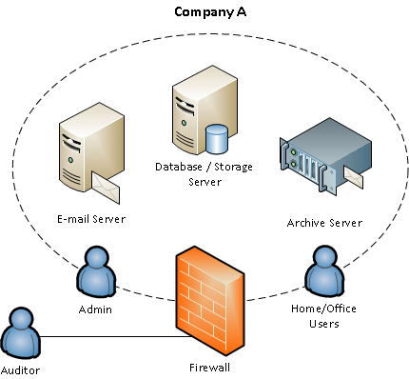
Life Before Cloud Computing
On-premise software = software installed on computer of person using it
Hardware, operating system, and server all bundled together
Example: If a company had an email service, they would have server hardware located in the company
Notes:
In order to understand the importance of cloud computing, it is important to understand why and how the cloud came to be what it is today. Prior to the development of cloud computing, all software was considered to be “on-premise”.
On-premise software is software that is installed on the computer of the person using it. This means that the hardware, operating system, and the server that applications run on are all bundled together. For example, if a company had an email service, they would have physical server hardware located in the company to run that email service.
Maintain own server to host a website
Servers are expensive
Higher traffic = more servers (traffic varies)
Upscaling = more difficult
Servers are difficult to maintain
Less time to focus on business
Amount of data higher now

Slide 4
Drawbacks with On-Premise Software
Exchange server dependent on everything between it
Hardware failure makes it so that service cannot operate
Users must manage, install, and update software themselves on local servers or computers

Slide 5
Servers Before Cloud Computing
Own and maintain servers to host a website
Servers are expensive
Company has to dedicate time and resources to maintaining the servers
More data now - maintaining this amount of data would not be feasible without the cloud
Difficult to adequately secure server from outside attacks
Upscaling is difficult due to the need for more servers

Slide 6
Development of Cloud Computing: Timeline
Early Mid-90s
Network schematics show overlapping server icons resembling clouds
1999
Salesforce launches one of the first successful software-as-a-service offerings
Early 2000s
Popularization of the virtual machine
1996
“Cloud” becomes a metaphor for parts of a network that can be accessed from any number of devices through the internet
2006
Amazon launches AWS (Amazon Web Services) - Start of quick transition towards cloud computing
Notes:
Due to the problems with on-premise software, many computing companies began to invest time into changing the structure of servers.
In the early mid-90s, the metaphor of the “cloud” was developed. Network schematics with overlapping server icons began to resemble clouds. The term “cloud” began to be used to describe areas on a network that required little explanation to understand. This was the start of the “cloud” becoming somewhat of an ambiguous term to the everyday computer user.
In 1996, companies (such as compact computers) began to market around these cloud services. The term “the cloud” became a metaphor for parts of a network that can be accessed by any number of devices over the internet.
In 1999, the company Salesforce launched one of the first successful software-as-a-service offerings.
1999 - VMware introduced VM virtual platform
Virtual machines: Use software instead of a physical computer to run programs and deploy applications
It took almost ten years for cloud computing to really take off and popularize in the public. It wasn’t until 2006, when Amazon Launched their Amazon Web Services, when cloud computing became extremely popular in the public eye and more cloud storage providers began to emerge

Slide 7
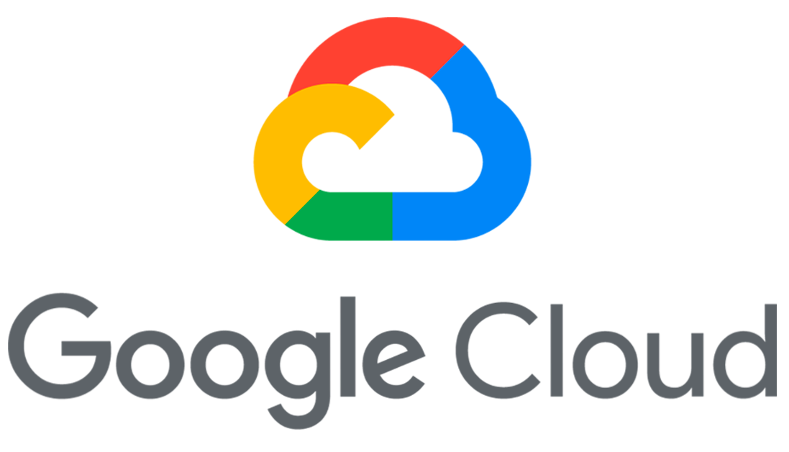
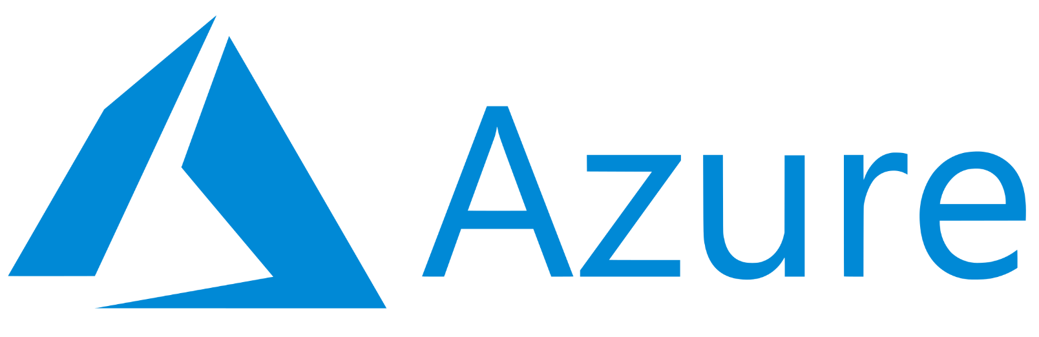
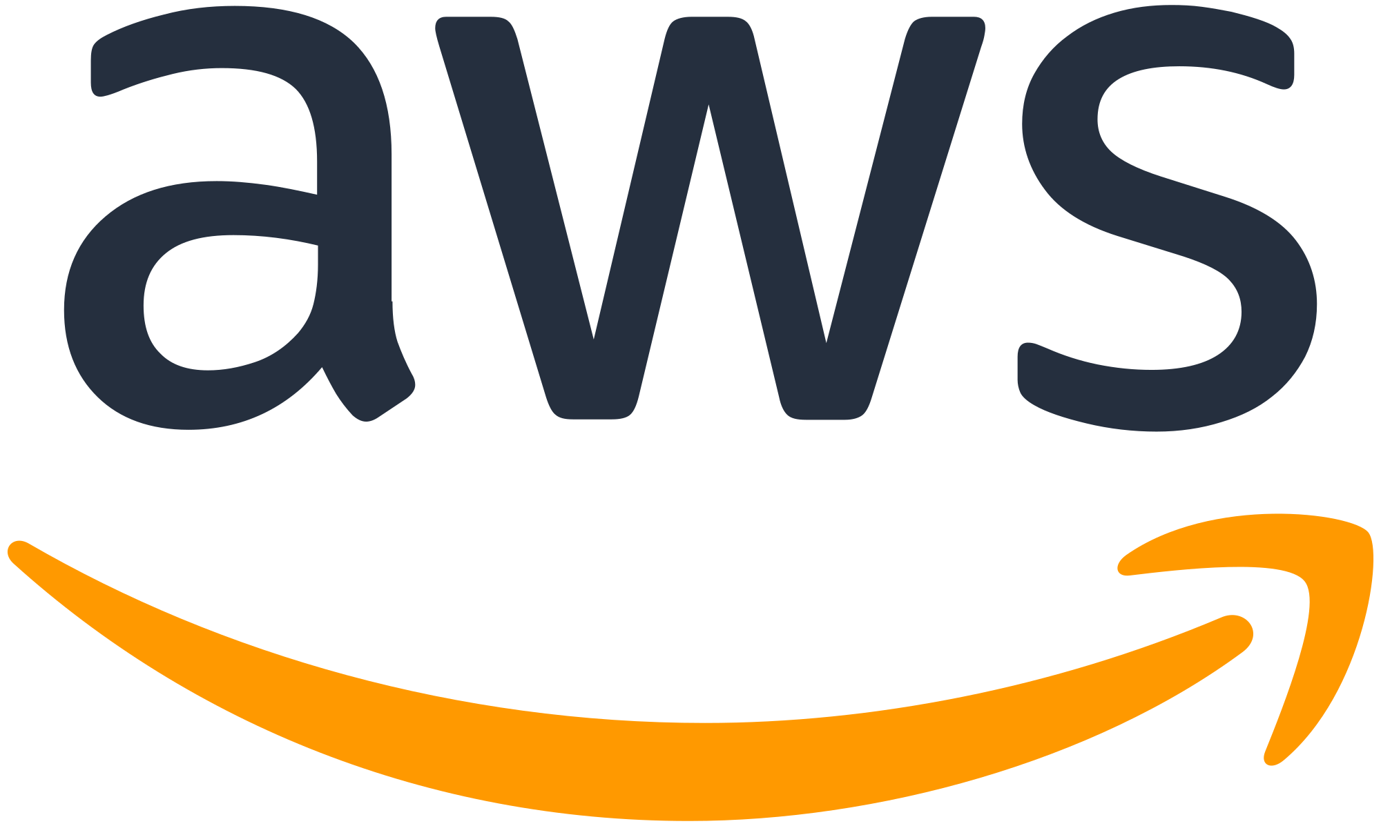
Notes:
Currently, some other popular cloud services include Microsoft’s Azure and Google Cloud.

Slide 8
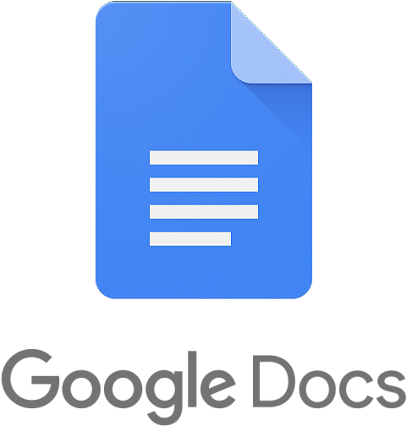
Example Utilization of Cloud Computing
Google Docs
Write applications as if application is installed on your computer without actually having to install an application
Can finish work from another computer if your computer fails
Notes:
One of the most basic examples of software that uses cloud computing is Google Docs. The benefits of Google Docs compared to on-premise text editor software such as the original Microsoft Word (although Microsoft 365 does use cloud services).
This example encompasses how cloud computing can be beneficial in all areas of the digital world
With Google Docs, no installation of the application is necessary. Instead, a user just accesses the application through the internet
When a user uses Google Docs, they can access the application from any device. When they open up the application, their previous work is saved no matter what device they are on. Whereas with an on-premise text editor, they could only access their saved documents from the device that they originally created the document on.
If the user’s hardware fails, they do not lose all of their work

Slide 9
What is Cloud Computing
Cloud = decentralized location to share information through satellite networks
On-demand availability of computing resources for a pay-as-you-go price
No active management of resources by user
Each cloud application has a host
Hosts of the application maintain massive data centers
Provide security, storage capacity, and computing power
Access to internet = access to applications

Slide 10
Public, Private, Hybrid, and Multi-Clouds
Public = computing services and infrastructure managed by third party provider
Private = Infrastructure dedicated to a single users
Hybrid cloud = Multiple private clouds for different uses
Multi- cloud = Multiple public clouds
Notes:
Hybrid cloud always includes a private cloud
Multicloud always uses more than one public cloud service which performs different functions

Slide 11
What is Cloud Native
Computing approach that takes advantage of the cloud computing delivery model
Speed up the development and optimization of applications
Helps connect applications
Utilizes DevOps, continuous delivery, microservices, and containers
Altered software development and business models
Notes:
It is important to understand cloud computing because it created a platform for cloud native. Next seminar, we will dive into the details of cloud native and how cloud native apps are computed. For now, I will be giving an overview of what cloud native is.
Computing approach that takes advantage of the cloud computing delivery model
Exploits the scale, elasticity, resiliency, and flexibility of the cloud
Reduces developers operational tasks to allow them to build applications faster
Allows developers to make high impact changes frequently with little effort
Moving fast while remaining agile

Slide 12
Primary cloud service models
IaaS
PaaS
SaaS
FaaS
BaaS
Notes:
So our three primary cloud computing service models are IaaS, PaaS, and SaaS
Which are Infrastructure as a service, Platform as a Service, and Software as a Service.
There are also some other service models that are less common, of which, we will be talking about FaaS and BaaS
Which are Function as a Service and Backend as a service.
IaaS - Read: eye - as
PaaS - Read: pazz
Saas - Read - Sass
FaaS - Read - FaaZ
BaaS - Bass
Faaze

Slide 13
IaaS
Infrastructure as a Service
Infrastructure is provided by cloud provider
Infrastructure can be separated into three main categories.
Compute - General, GPU, HPC
Store - Object, Block, File
Network
Cloud provider maintains and supports the infrastructure
Everything else is handled by the user
Notes:
So at a high level one way that you can think of cloud is it being simply some other person’s computer that you have access to through a server.
Infrastructure as a service is essentially giving you access to varying degrees of hardware.
Infrastructure can be separated into three main categories. These are Compute, Store, and Network
Compute can be broken down further depending on your needs. 1. General purpose computing, 2. Access to gpu’s for example training machine learning or ai models.
3. High performance computing - for when you need high clock frequencies or access to many cores.
We also have different kinds of storage.
Object storage -In object storage, the data is broken into discrete units called objects and is kept in a single repository, instead of being kept as files in folders or as blocks on servers. Objects can’t be modified—you have to write the object completely at once. Object storage also doesn’t work well with traditional databases. - Very scalable, good for long term storage.
Block - Data gets chopped into blocks and stored as separate pieces - each block of data is given a unique identifier which allows the
Storage system to place the pieces of data wherever it is most convenient. When data is requested the blocks are reassembled. Doesn’t rely
On a single path - like file storage and
File - Data is stored as a single piece of information inside a folder
Our third category is the network.
We can think of our network as a pipe.
Depending on how much data we need to push simultaneously the larger pipe we need and the more bandwidth we need
*Another way that network traffic can be measured is by how much data gets pushed through the pipe over a set period of time
* Normally this is billed by the month but it can also be billed by the day, minute, second or week

Slide 14
IaaS - Benefits
Scalable
Cost depends on consumption
Single piece of hardware can serve many users
Most flexible and dynamic model
Easy to use as hardware and updates are deployed automatically
Management tasks are virtualized so employees have time for other tasks
Notes:
One of the primary benefits of the IaaS model is that you can quickly scale to your needs. Changes can take from minutes to hours. Which is far better than the weeks to months that you would have historically.
If you need more storage you can have it. (also if you need less!)
Secondary benefit - Your costs depend on your consumption. If you do not have a contractual agreement to utilize some baseline - which you typically would not, you do not pay for what you do not use.
You only use something as long as you need to - then you get rid of it and of course stop paying.
Another benefit - environmental as a single piece of hardware can serve many users, it can generally be thought of as achieving higher efficiency of overall resources.

Slide 15
IaaS - Cons
Data security
Training
Loss of access to data
Notes:
Data security can theoretically be an issue,
However, due to high levels of security on site, and utilization of encryption
Typically, organizations can take advantage of more advanced and robust security
Than they would be able to provide on their own if they kept everything on site.
Additionally, you are responsible for your IaaS provider’s mistakes are now your mistakes
As you put your trust into them.
In the event that cloud provider security breach puts your business’s data at risk or more specifically your customers data - the fact that it wasn’t “your fault” is of little comfort
Another con of switching to using IaaS is that training is inevitably required for employees that will be involved with this usage.
Finally, if the server crashes at the vendor side - you cannot access your data!. - As usual wasted time is wasted money.

Slide 16
PaaS
Platform as a Service
Cloud provider provides hardware and software
Usually just those needed for software development
Only worried about your application
Notes:
Here along with the platform, the operating system is provided as well as well as the runtime which is essentially the glue between the operating system and your application.
This is the environment that your application operates in.
So all you have to worry about (and focus on) is your application itself.
PaaS is similar to renting a car. You are not investing time or money into customizing the car you are just using it temporarily to get where you need to go.
You are driving and paying for gas.

Slide 17
PaaS - Pros
Fast and easy to get an application up and running
Easy to create and delete resources as needed
Cost benefits
A lot of tools are typically provided with your platform

Slide 18
Paas - Cons
Lack of control
Vendor lock-in
Performance at scale
Notes:
There is a distinct lack of control with regards to infrastructure fine tuning. (Some will say this is a pro as they do not want to have to deal with it)
It is not always easy to migrate a Platform as a service app from one cloud to another - Important to choose the right provider for you so you dont wind up wanting to switch
Performance at scale can be an issue - apps will typically have worse performance on a shared platform than they would on a dedicated server.

Slide 19
SaaS
Software as a Service
Sometimes called “Cloud application services”
Ready to use application software
Notes:
Software as a service is essentially just third-party applications that you do not have to install locally on your machine.
Now typically these services are paid for using a subscription model on a monthly or yearly basis.
If the service is free there is a good chance that you are paying on a lifelong basis as they are presumably harvesting and selling your data.
So, one example that we have all used is Youtube, you do not need to install a media player on your device to watch videos,
Can simply stream off of youtube. Similarly, Google docs, sheets, etc.

Slide 20
SaaS - Pros
Software does not need to be installed locally
All updates are handled by the provider
Pay as you go
Minimal risk - often free trials are available
Notes:
So for SaaS some of the main benefits to the user are that the service provider manages the application and the associated infrastructure
Used to run it.
All that you need is a strong internet connection and a web browser in order to access the software.
Now like we said SaaS typically runs on a subscription model which can be preferable to what was previously the norm where you
Would typically need to buy software outright if you wanted to use it for commercial means.

Slide 21
SaaS - Cons
Typically subscription based (could be a benefit)
Automatic updates (also could be a benefit)
Notes:
One con of the SaaS model (for the user) is that it is typically ran off of a subscription model.
While this could be cheaper (and beneficial) depending on your needs if you only need the software for a short period of time
Eventually subscription costs could go past what you would have spent simply purchasing and installing similar software locally.
In addition to SaaS typically being subscription based, another con with the SaaS model is that software is typically updated automatically,
While this can be good for security (in theory) it can also introduce bugs and vulnerabilities. Automatic updates can also lead to a need for
Retraining on these updates which can be costly in terms of time and productivity.

Slide 22
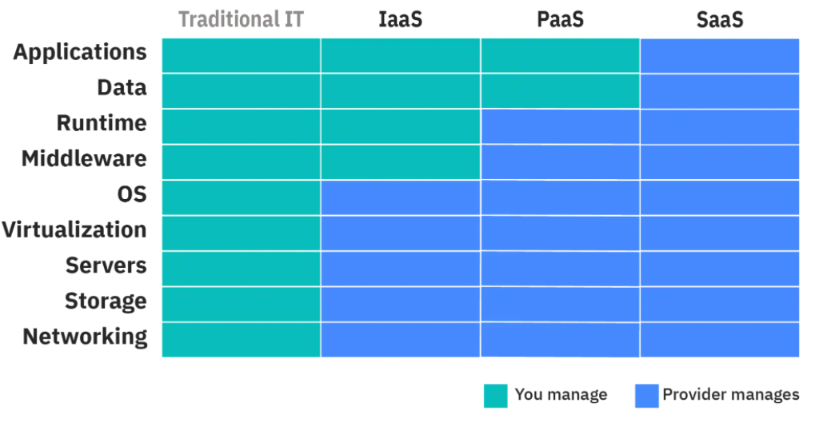
Who manages what?
Notes:
Middleware is software that lies between an operating system and the applications running on it. It Essentially functions as a hidden translation layer, middleware enables communication and data management for distributed applications.

Slide 23
FaaS
Functions as a service
Initially offered by various startups as far back as 2010
Use cases are primarily “on-demand” functionality
Notes:
Outside of the primary cloud service models to start with we have FaaS which is function as a service
So essentially what Faas does is it abstracts your application so that you only need to focus on the functions.
The functions are the individual components which make up the application.
Essentially, you provide the code to the cloud provider and they are responsible for running it on demand.
To use FaaS - You do not need a server - while not immediate - FaaS can be utilize in anywhere from a second to milliseconds.
One example of a FaaS use case would be data processing for a mobile app.

Slide 24
FaaS - Benefits
As with other cloud models, pay for what you use is a major benefit of FaaS
Only pay for function execution time - Not idle time
Does not require constant server time
This leads to lower costs
There is increased latency
Still relatively quick

Slide 25
BaaS
Backend as a Service
Allows companies to delegate backend and focus instead on production and the client side of an application
BaaS can take many forms
Notes:
BaaS could be Database management and optimization,
Cloud storage and hosting
User authentication, verification, management, storage of user-generated content
Etc. etc.

Slide 26
BaaS Benefits
Reduced time to market
Can focus on core business
Do not have to worry about many of the details
Can give more focus to the front end and overall user experience
Can enhance security
Notes:
Since there are ready to use backend solutions you can have a greatly reduced time to market.
This can of course save money by reducing development costs.
With ready to use solutions, you can have greater assurances that they have been properly tested and are by and large secure.

Slide 27
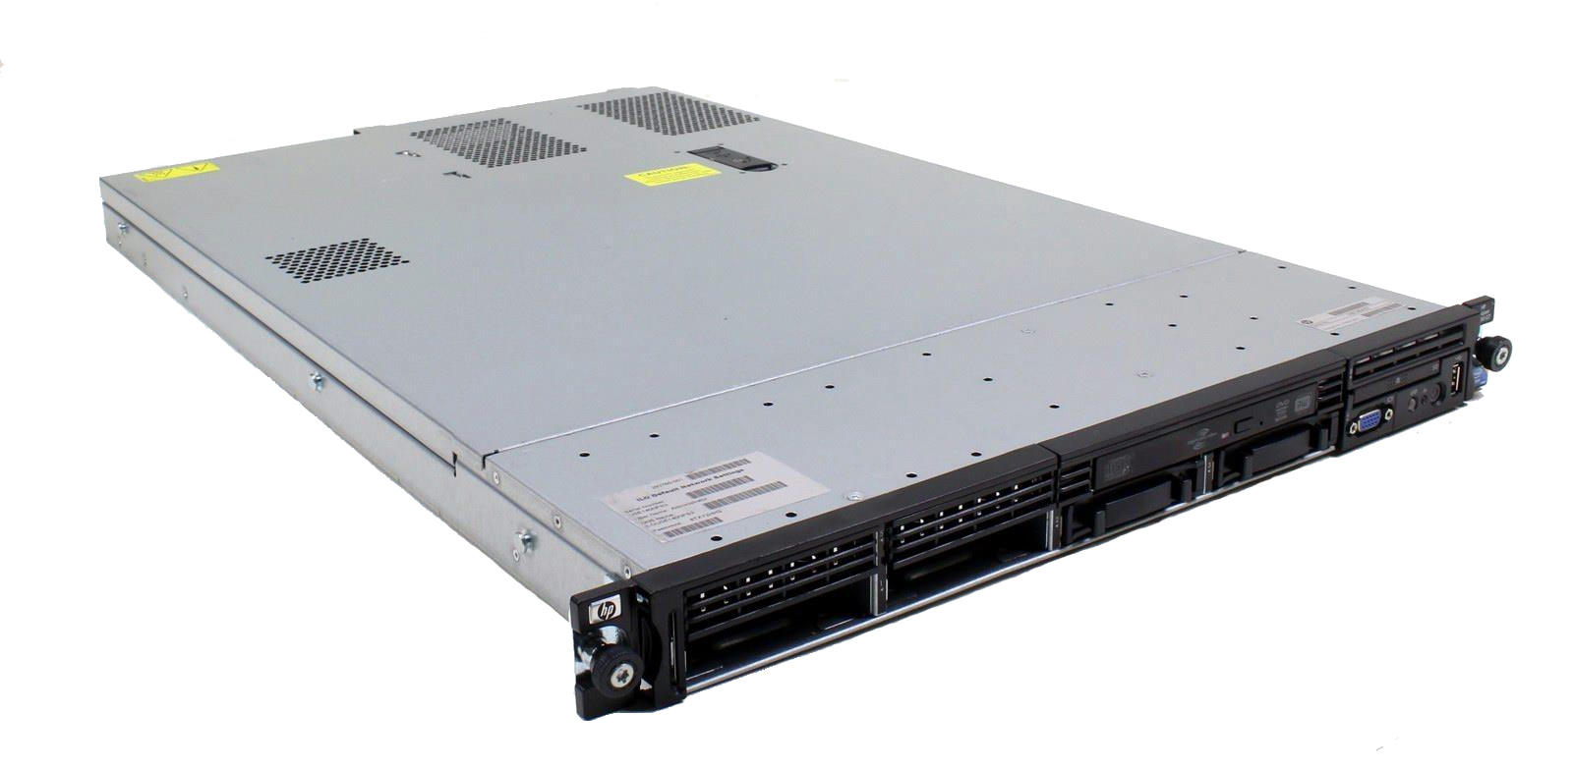
Virtual Machines
Notes:
When you start hosting applications in the cloud, one of the big problems you run into is security. How do you make sure your app isn’t easily compromisable? When you develop an application locally on your computer, you have all of the components installed on that one device. You have the database, the front of your application, etc.
But when hosting applications in the cloud, that isn’t safe from a security perspective. If one app gets compromised, all other apps could get compromised.
One solution: host each application on a separate server. That way they’re isolated from each other But that’s expensive. Maybe the application uses only 10% of the server’s CPU.

Slide 28
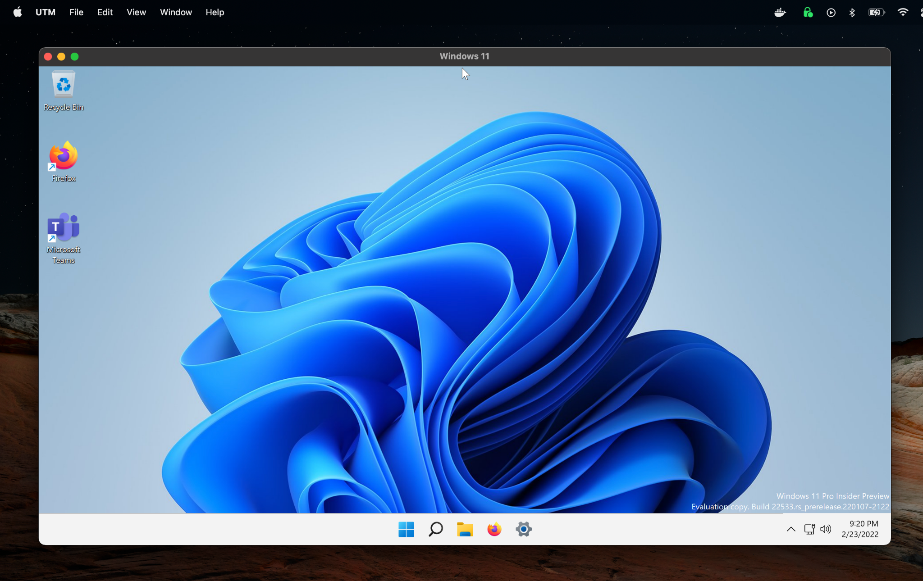
Virtual Machines
Notes:
That’s where Virtual Machines comes in. Virtual Machines are a computer within a computer.

Slide 29
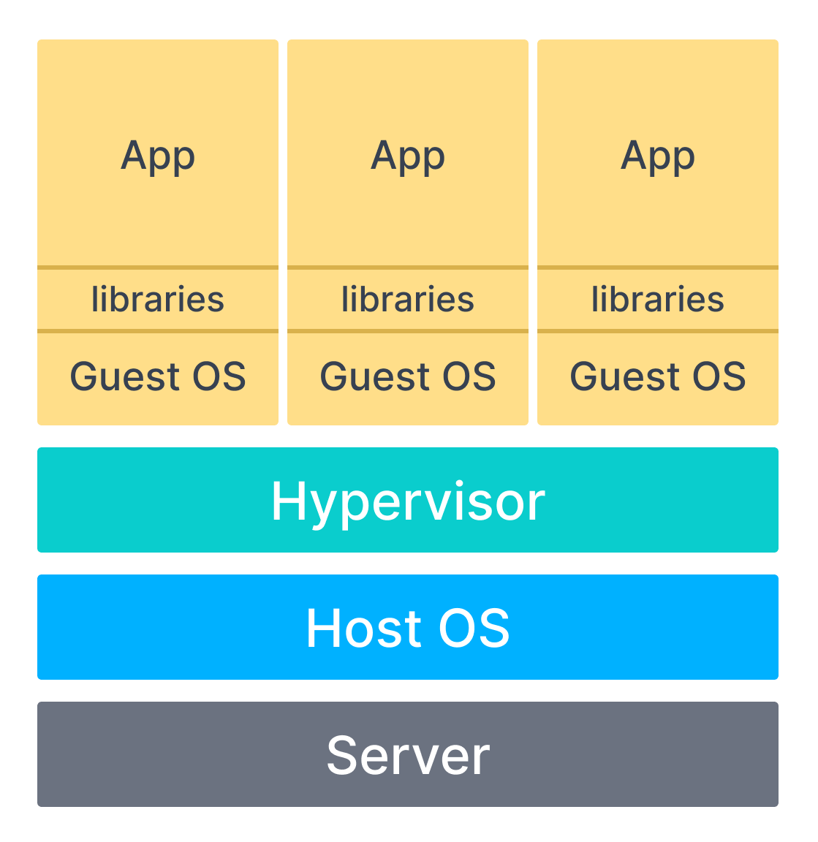
Virtual Machines
Notes:
With Virtual Machines, you have a separate operating system than server itself. We refer to as the server as the “host” and the virtual machine as the “guest.” So it’s like running Linux on top of Windows.
Hypervisor - software that creates a virtualization layer between the host Operating System and the guest Operating System. The server (aka host)’s resources (CPU, memory, storage) are treated as a pool that can be allocated to virtual machines. Hypervisor manages this allocation and network communications between the virtual machines.
Libraries = the dependencies needed to run the app. Ex: Python packages or NodeJS packages
Advantages of VMs:
Isolated. Each VM is separate from one another. They can’t see the other VMs and they can’t interact with the Host OS unless you changed some settings in your VM software program to allow them to. If someone were to remotely login to one of the VMs, they would not know it’s a VM at first glance. It appears just like any other computer. This isolation improves security because if one VM were to be compromised or have an issue that causes it to become corrupted, the other ones would not be affected.
You can run multiple Operating Systems. If you need to run Windows Server for some apps and Linux for others, you can do that
Cheaper than multiple servers
Disadvantages
Resource intensive. It takes a lot of memory to be able to run multiple virtual machines and they can eat up a lot of CPU. You have to set aside specific amounts of memory and CPU storage for it like 2 cores for this app. As a result, some apps may be inefficient in their CPU usage
Slow to setup. It takes time to install and configure the Guest Operating System

Slide 30
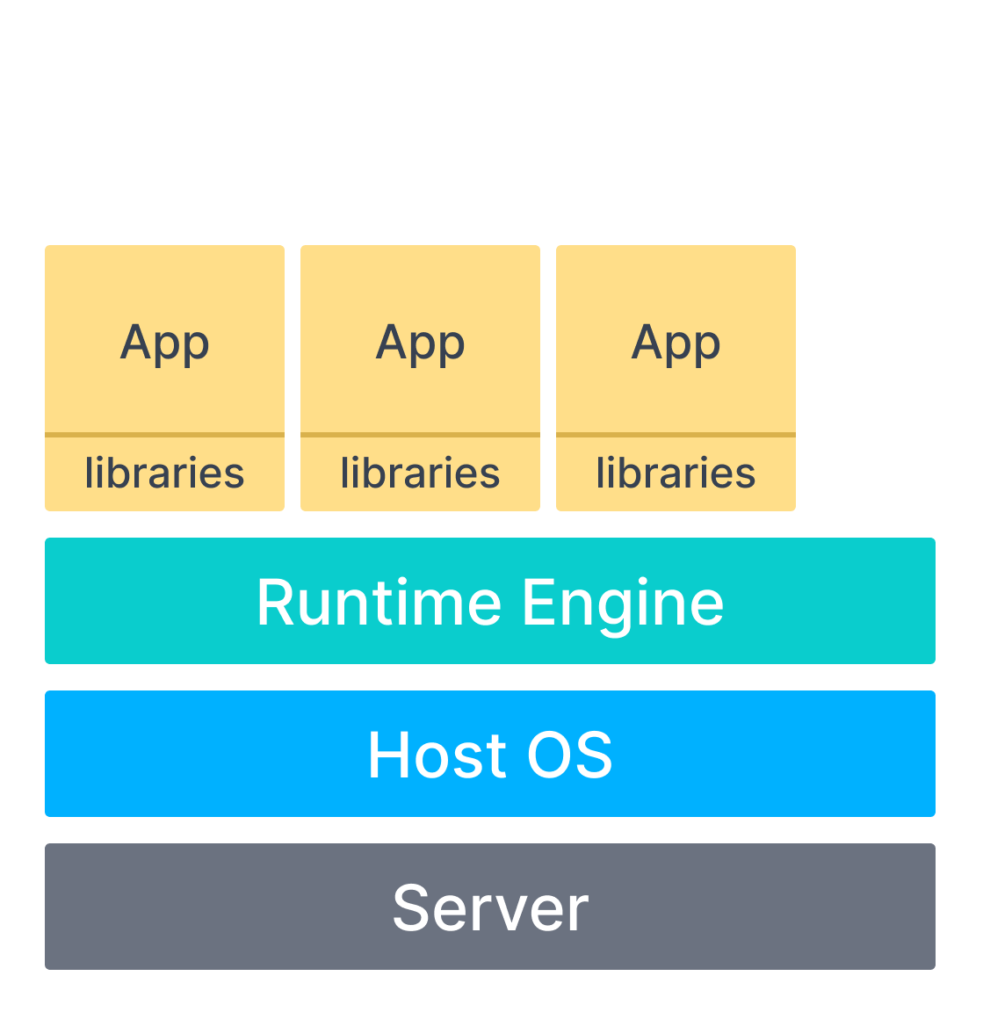
Containers
Kernel
Notes:
Containers are much more resource efficient. Instead of having a separate operating system for each container, you share the Kernel of the host operating system with all of the containers. So if your server is running Linux, all of the containers will run Linux. This is obviously much more resource efficient because you avoid unnecessary duplication, but it comes with a tradeoff: you can’t run a container with a different operating system from the host. So if you wanted a Windows container, you would have to use a Windows Server, not Linux. So containers are not exactly VM killers, VMs will still hold a place for years to come in cloud computing.
But how does containerization work? This seems like black magic. Let’s take a closer look

Slide 31
Containers
Image
Notes:
Each container has an image, which is the application, its dependencies and its configuration all packed together in a single file. You can think of this like a zip file
Containers are portable. You can deploy them across different environments with usually no modification. Speeds up development time.

Slide 32

Containers
Notes:
Most popular runtime engine

Slide 33
VMs vs Containers
VMs
Pros:
Secure
Multiple Operating Systems
Cons:
Resource intensive
Slow to setup and configure
Containers
Pros:
Secure
Very resource efficient
Fast setup
Cons:
Limited to just Host OS

Slide 34
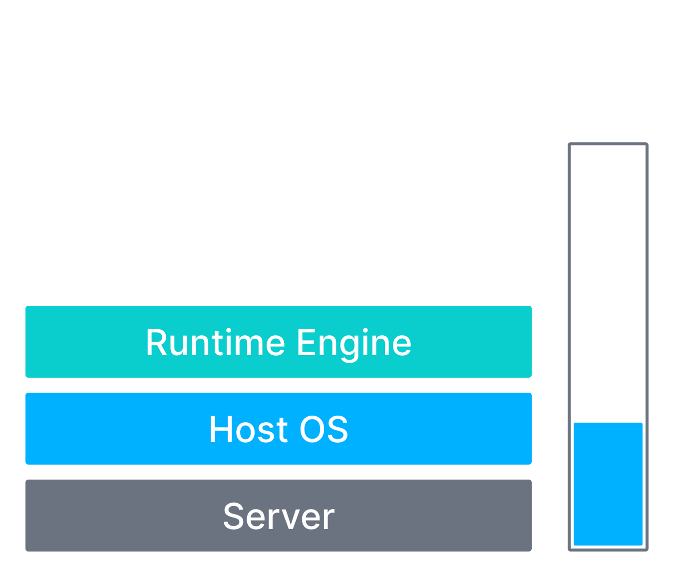
Containers
Resources
Notes:
Even though containers are more resource efficient than VMs, at some point, you will still inevitably run out of resources. Something like this will happen

Slide 35
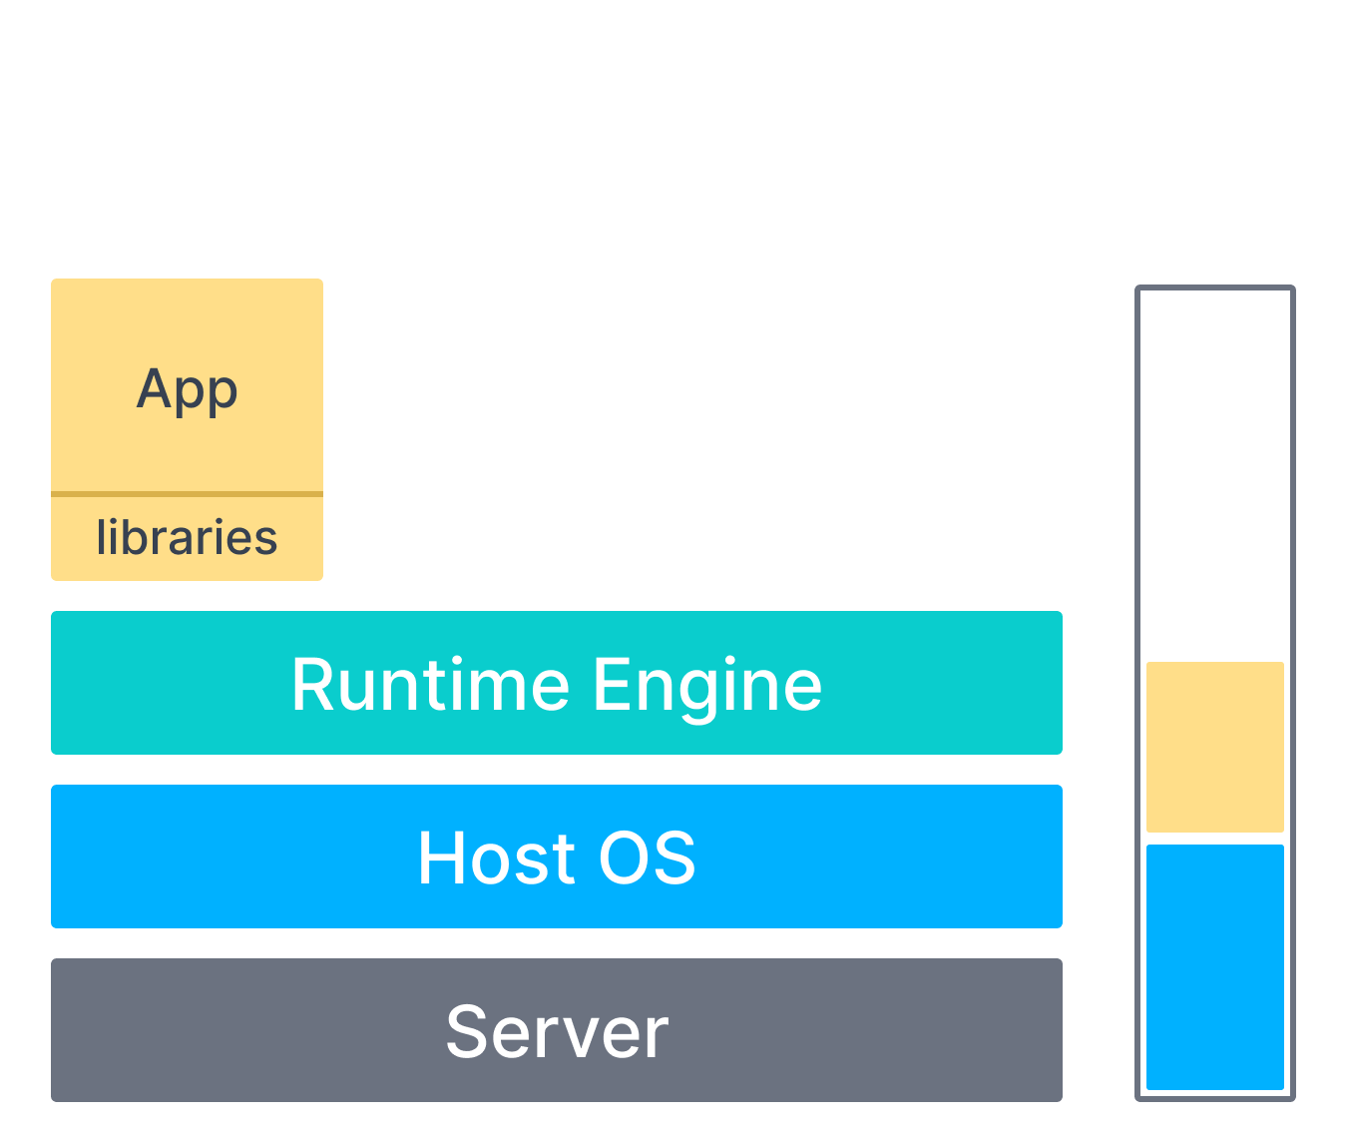
Containers
Resources

Slide 36
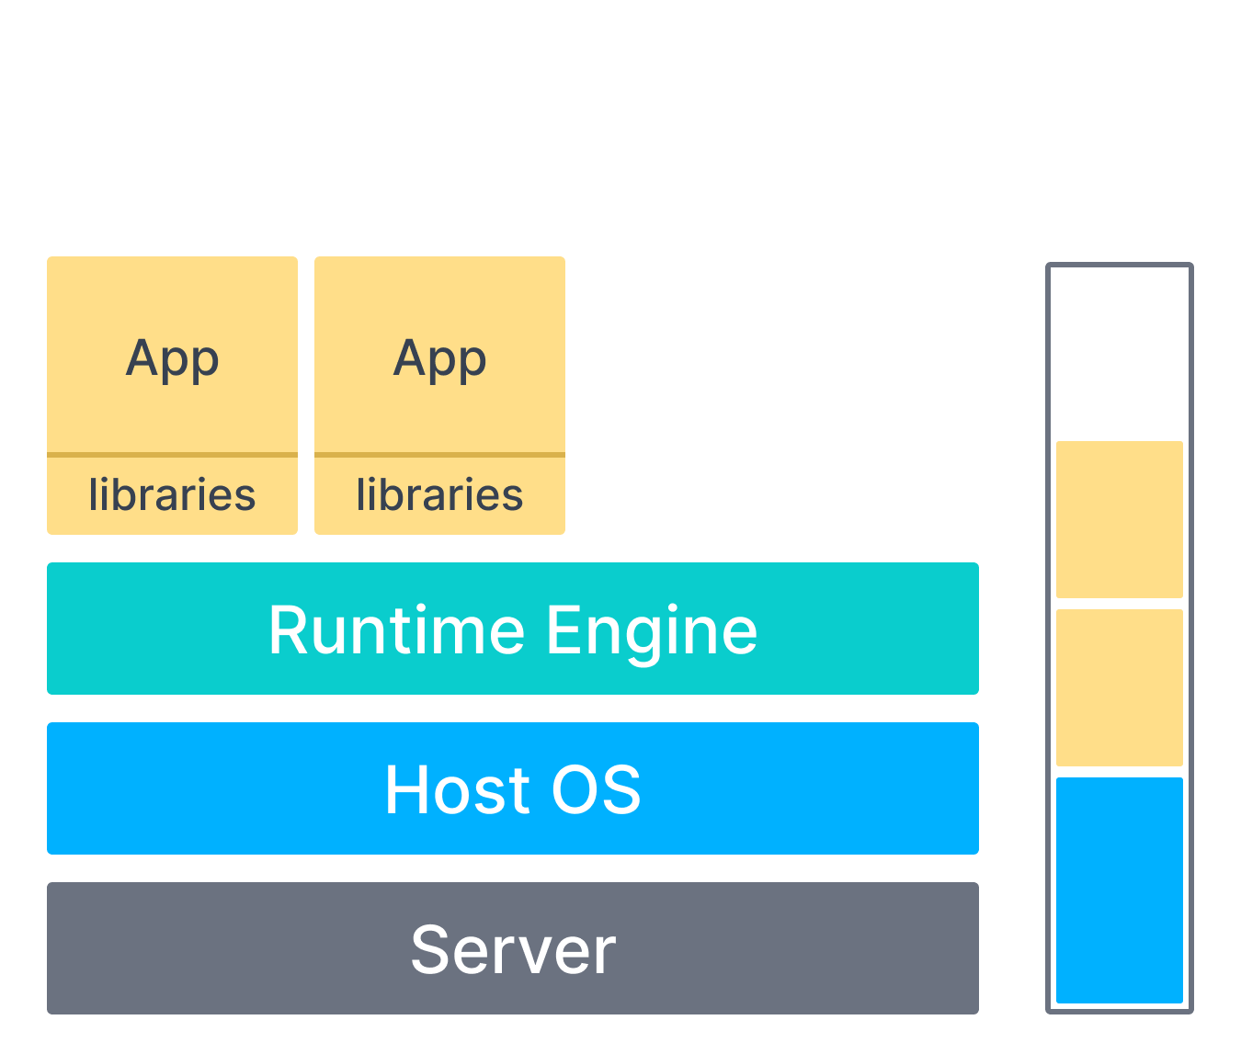
Containers
Resources

Slide 37
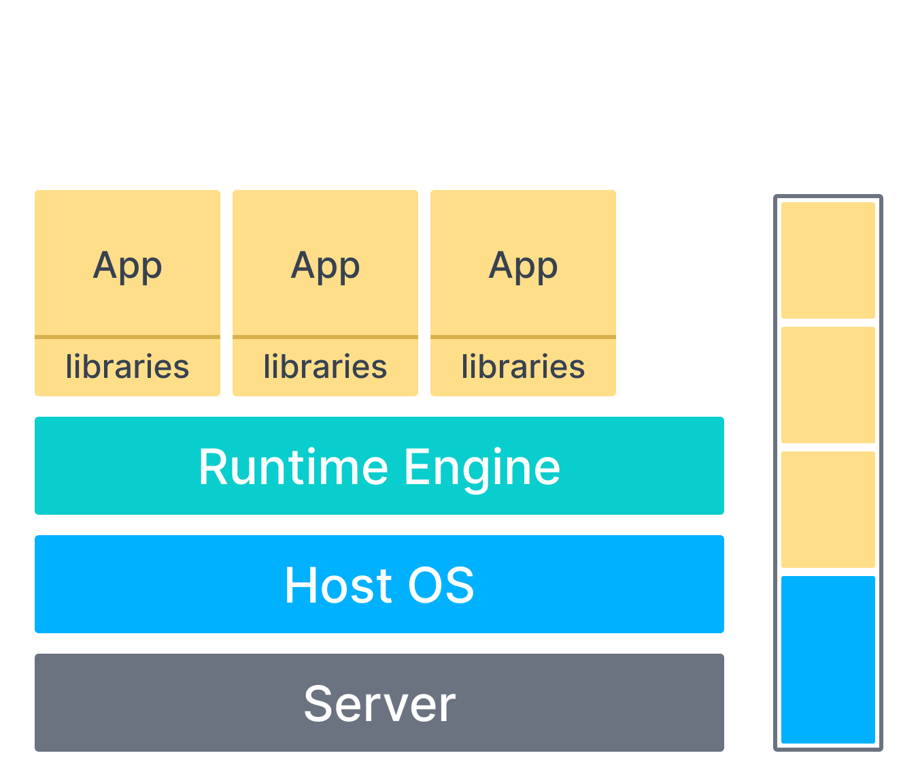
Containers
Resources
Notes:
So what do you do?

Slide 38


Containers
Resources
Resources
Notes:
Well you could just buy another server and spin up some more containers. But what do you do if this happens again?

Slide 39
Containers
Resources
Resources
Notes:
and you run out of resources. Well you could just repeat this process over and over again, but there’s a better way

Slide 40
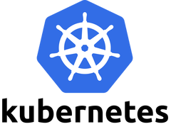
Container Orchestrator
Container orchestrator
Automates the deployment and managing of containers.
Used in conjunction with a container engine and container runtime
Notes:
That’s where container orchestrators comes in. Container orchestrators automatically handle the common tasks you would otherwise have to do yourself manually like spinning up a new container, allocating their resources, etc.
The most popular container orchestrator is Kubernetes
One thing to note is container orchestrators like Kubernetes aren’t replacements for container engines like Docker.
Developers are still going to use Docker locally on their laptop to setup containers and test new things. Still going to be used for Continous Integration and Continous Development of containers (CI/CD)
Kubernetes is used when you want to deploy your containers to production and manage them easier.

Slide 41
Kubernetes
Deployment
Scaling
Coordinating between multiple hosts
Notes:
Use cases:
Deployment. Normally if you wanted multiple containers you would have to manually spin them up, but with Kubernetes you can deploy multiple containers with a single command
Can scale up and down containers to spread the application’s load more evenly. Ex: allocated each container only 2 CPU cores by default, but are finding one container is maxing that out. Kubernetes can automatically increase the amount of resources allocated it
Can perform automatic rollbacks when something goes wrong in a container

Slide 42
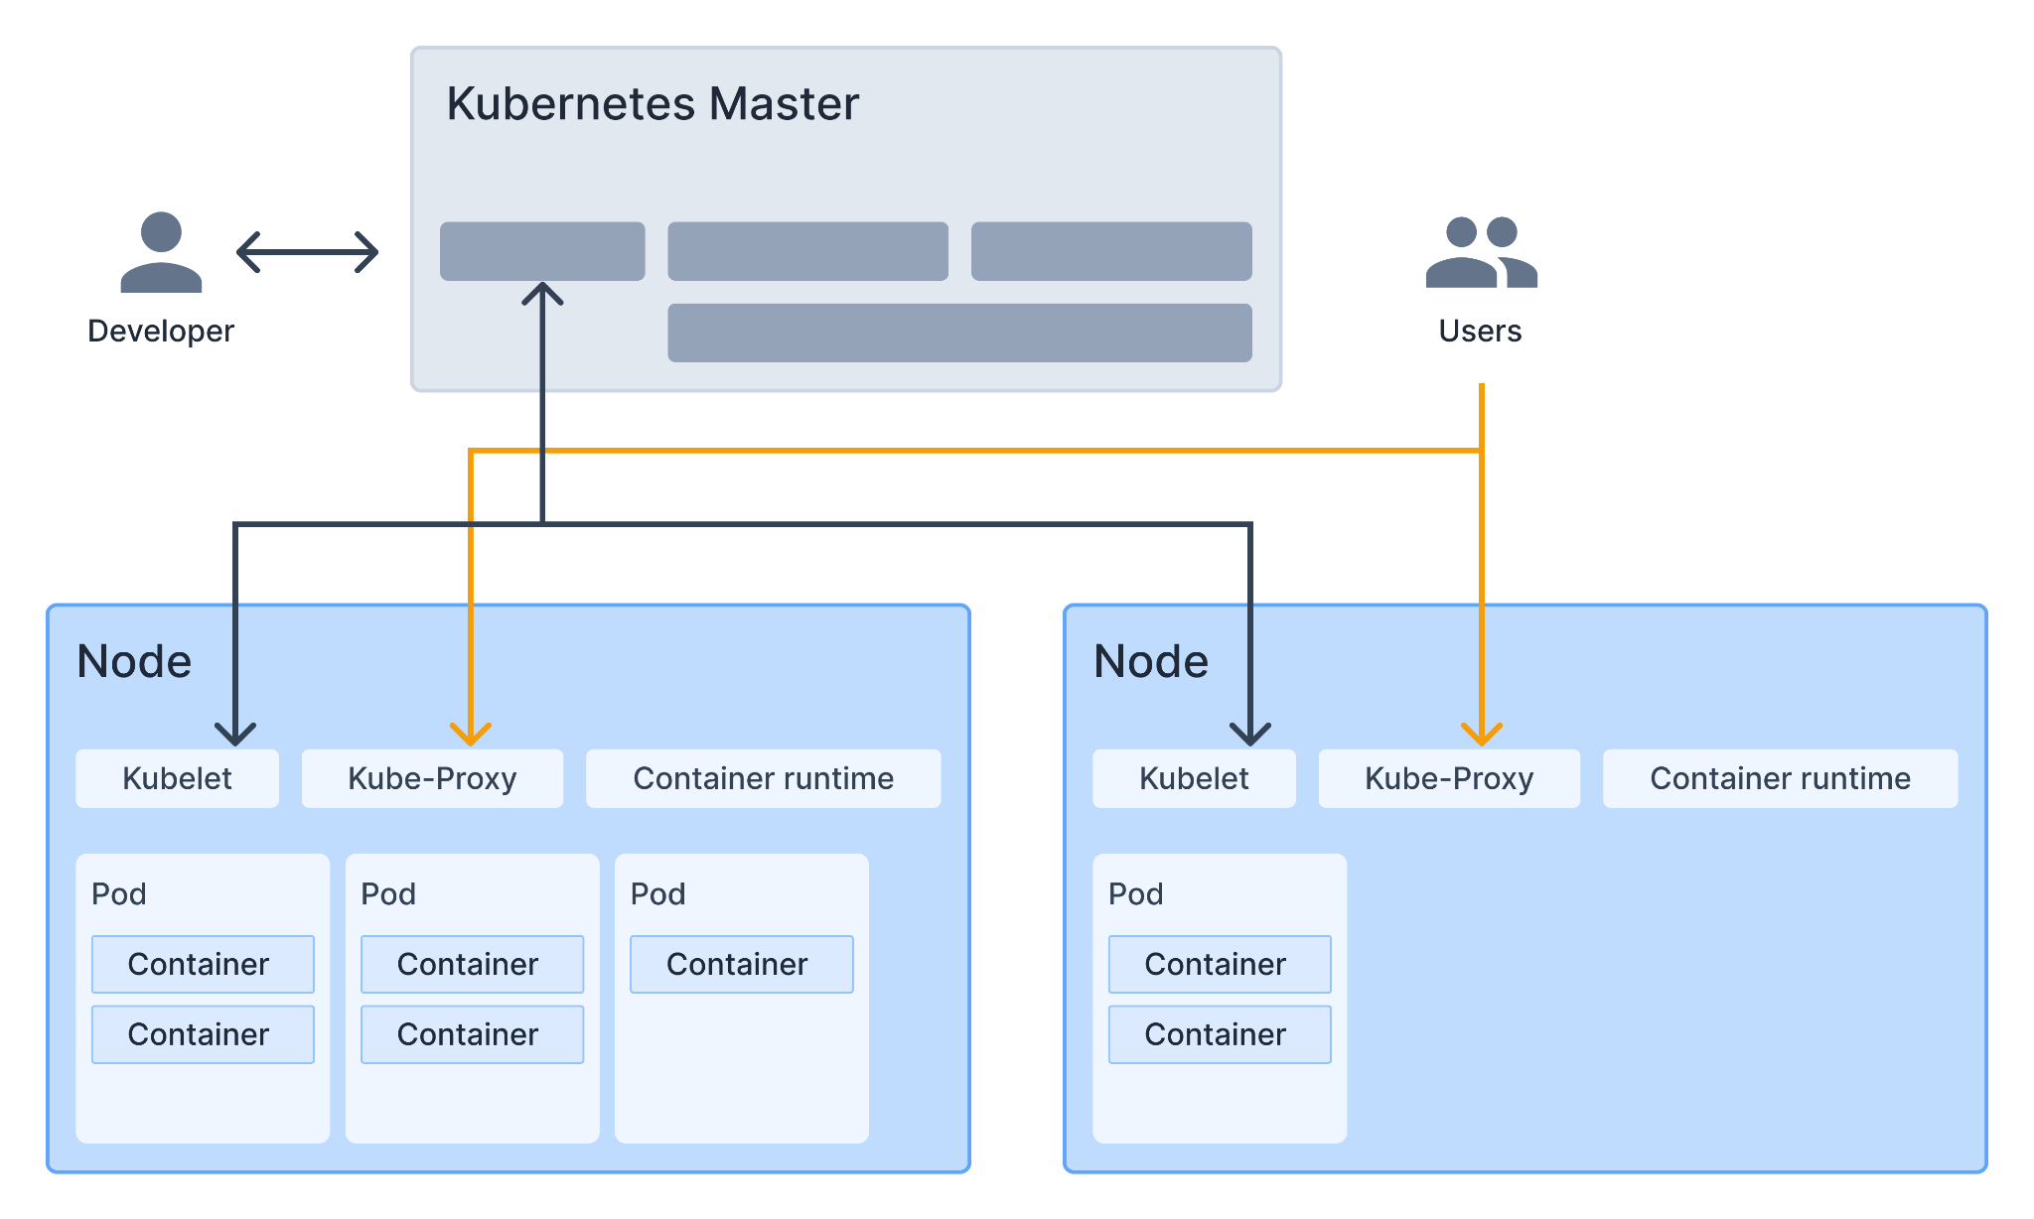
Notes:
Kubernetes is a cluster of servers.
One master node is responsible for managing all other nodes.
Each node contains pods, which can have 1 or more containers.
Users communicate with the the containers through each node’s Kube-Proxy.
Kubelet communicates back with the Master Node.

Slide 43
Demo
Notes:
Exit out of presentation and show Docker and Virtual Machine demo

